Slide 1

Julia-Based modelling and optimization of Renewable Hydrogen Production from PV and Wind:Case Study of Algeria
Presenter: Nadji Agadi
Position: Doctoral Researcher at the Technical University of Berlin (TU-Berlin)
Co-supervisors: Dr.Kristin Dietrich, Prof. Dr.Christian von Hirschhausen (TU-Berlin).
Nadji Agadi | Doctoral Researcher _Industrial Engineer | ENERDAY 2026 - 20th International Conference on Energy Economics and Technology | 23-03-2026

Slide 2
Agenda
Introduction :
Hydrogen potential from renewable energy in Algeria
Algeria: Hydrogen Exporter through European Agreement
An overview of the research
Research objective and research process
Data collection and Implementation
Results and sensitivity analysis
Conclusion and discussion

Slide 3
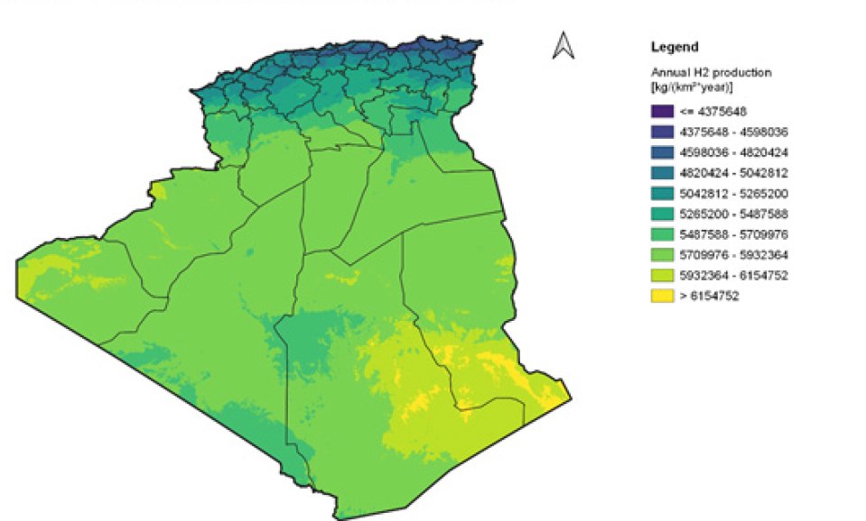
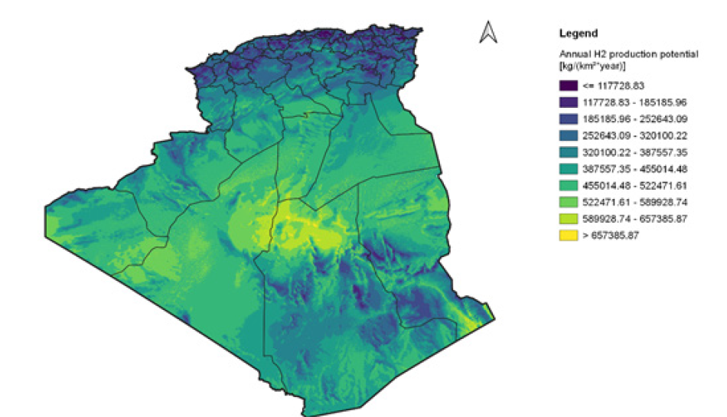
Introduction_Hydrogen potential from renewable energy in Algeria
Hydrogen production potential from PV electricity(source : GIZ Algeria ,2021).
Hydrogen production potential from onshore wind electricity(source : GIZ Algeria ,2021).
Notes:
Spatial overview of the Technical annual production potential Kg /(km2*year)
Algeria : Hydrogen production potential from PV electricty ( capacity ratio 1.5)
Algeria : Hydrogen production potential from onshore wind electricty

Slide 4
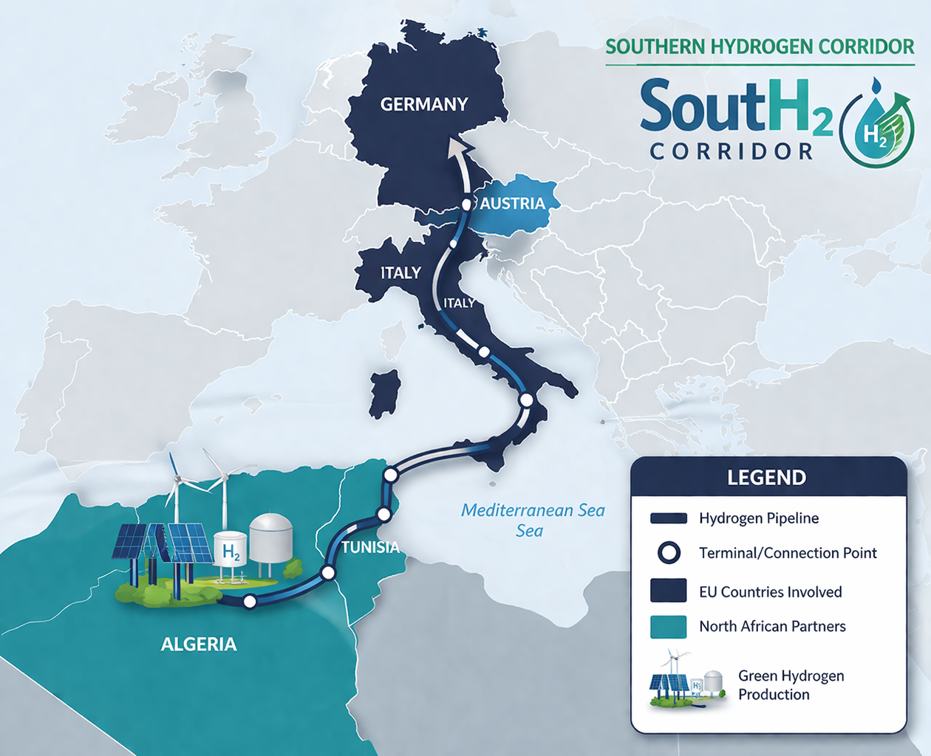
Introduction_Algeria: Hydrogen Exporter through European Agreement
Algeria is positioning itself as a future exporter of hydrogen from renewable energy, supported by partnerships with Germany and the European Union.
Estimated potential to produce up to ~40 TWh/year by 2040.
Long-term ambition to supply around 10% of European hydrogen demand.
Key initiative: SouthH2 Corridor(3,300 km pipeline connecting Algeria → Tunisia → Italy → Austria → Germany, with 4 million tonnes per year (Mtpa)), aiming to transport hydrogen from Algeria to Europe.
South H₂ corridor project (Source : AI generated ,2026)
Notes:
Algeria: Hydrogen Exporter through European Agreement
Sources:
European Commission (hydrogen import strategy & partnerships)
GIZ – Algeria–Germany Energy Partnership reports
Dii Desert Energy (hydrogen potential studies in North Africa)
International Energy Agency – hydrogen market outlooks

Slide 5
An overview of the research
Research Objective : To develop and optimize an integrated multi-regional renewable energy system in Algeria that maximizes profit from hydrogen exportation and electricity supply, by determining optimal production, storage, and energy flows under a techno-economic framework.
Research process:
Literature Review: Examined previous renewable hydrogen system models and identified research gaps.
System Design: Integrated PV, wind, battery storage, seawater desalination, electrolysis, hydrogen storage, and fuel cells across two regions
Technical Model: Formulated a techno-economic optimization model.
Data and Implementation: Collected hourly 2023 renewable data (NASA POWER) and implemented the model in Julia + JuMP.
Optimization and Analysis: Solved the linear program to determine optimal capacities ,hydrogen profit and electricity supply revenues.

Slide 6
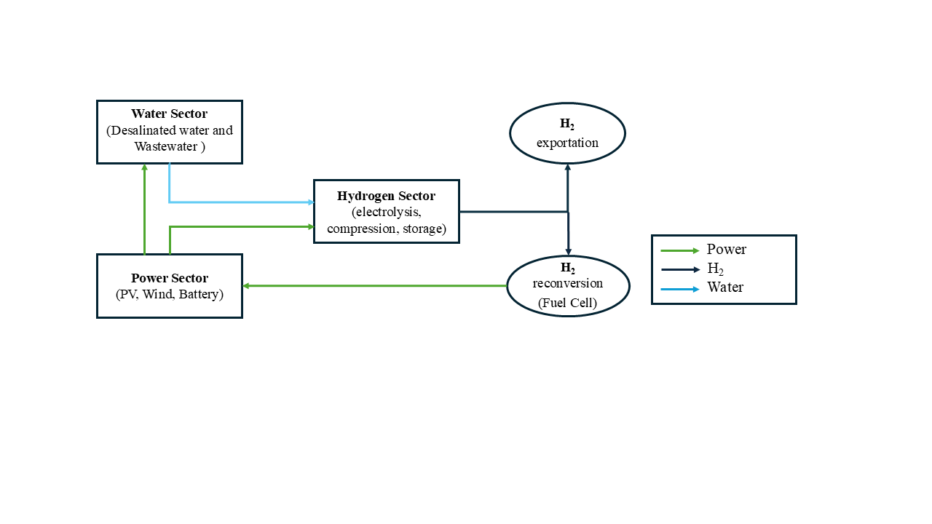
Methodology_System Design
Power: PV and wind generation (hybrid systems).
Storage: Batteries ensure continuous electricity supply.
Water: Desalination and treatment for electrolysis.
Hydrogen: Compressed storage for flexible use.
Conversion: Fuel cells supply electricity to region.
System design, source: own elaboration

Slide 7
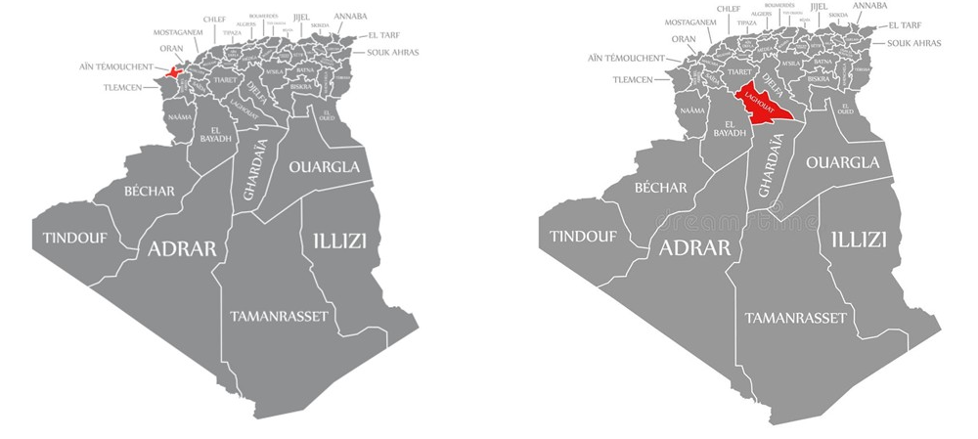
Data collection and Implementation
Criteria of selection : Technical, infrastructural, and geographical suitability
Model implementation:
Geographical Location of the Two Study Sites in Algeria: Ain Temouchent and Laghouat (source:VectorStock,2025)
Notes:
Locations: Ain Temouchent (coastal) & Laghouat (Sahara)
Site Selection: Based on renewable potential, water availability, and infrastructure
Wind Power: Vestas 4.2 MW turbines; output depends on wind speed & efficiency
Solar PV: 250 W panels; output depends on irradiance and temperature
Electrolyzer & Fuel Cell: 0.7 kg H₂/kWh; fuel cell 50 % efficiency; minimum 10 % load
Battery Storage: 90 % round-trip efficiency for reliability
Economics: Hydrogen export $3/kg; electricity $36/MWh
Modeling: Hourly 2023 NASA POWER data; implemented in Julia + JuMP; solved with HiGHS
Objective: Assess technical feasibility and economic potential of renewable hydrogen

Slide 8
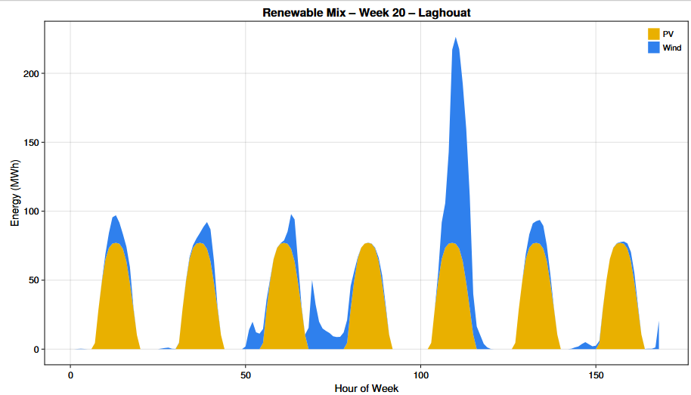
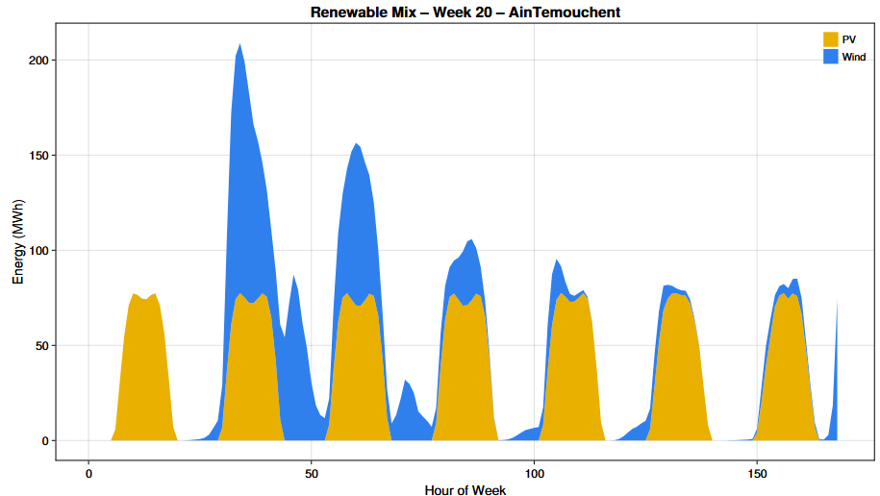
Results_renewable mix (PV and wind) generation
Source : own elaboration

Slide 9
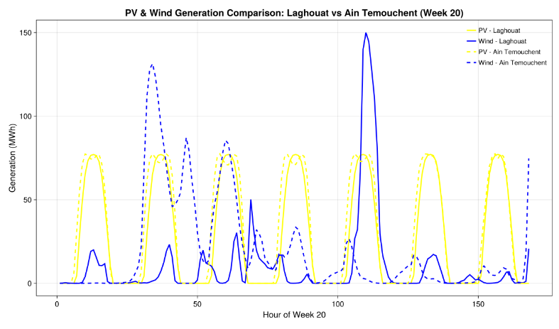
Results_PV and wind generation comparison: Laghouat vs Ain Temouchent (week 20)
Source : own elaboration

Slide 10
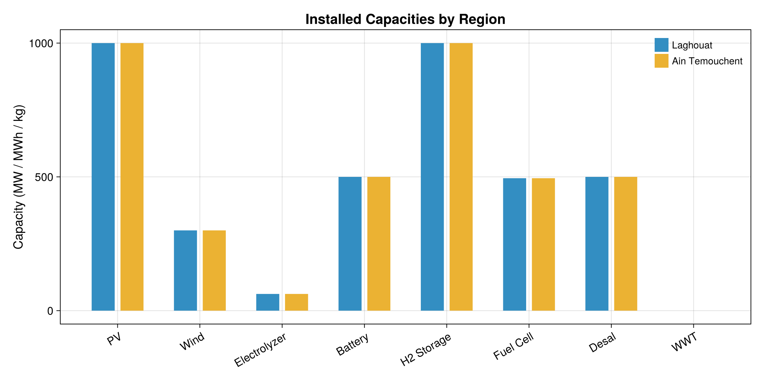
Results_Optimal installed capacities of generation, storage, and hydrogen-related technologies.
Installed capacities by region ,source : own elaboration

Slide 11
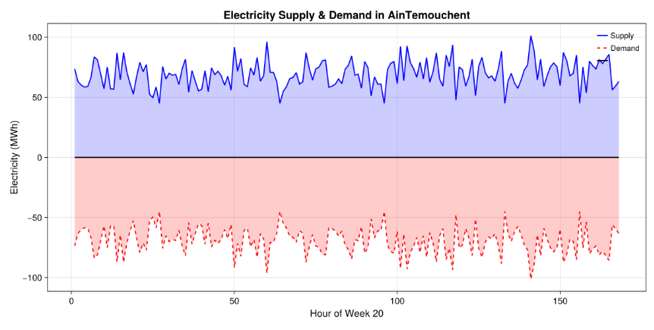
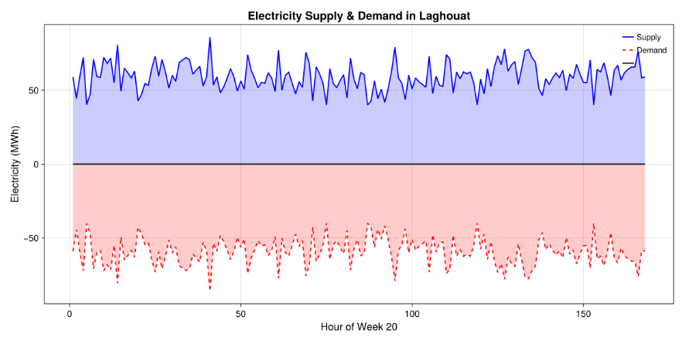
Results_electricity supply and demand
Source : own elaboration

Slide 12
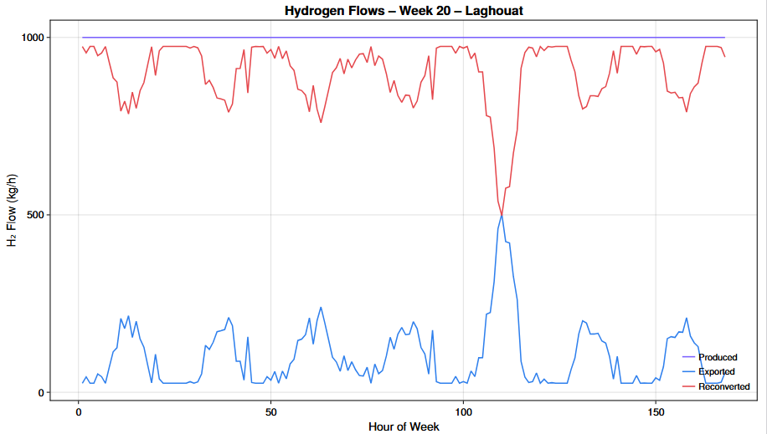
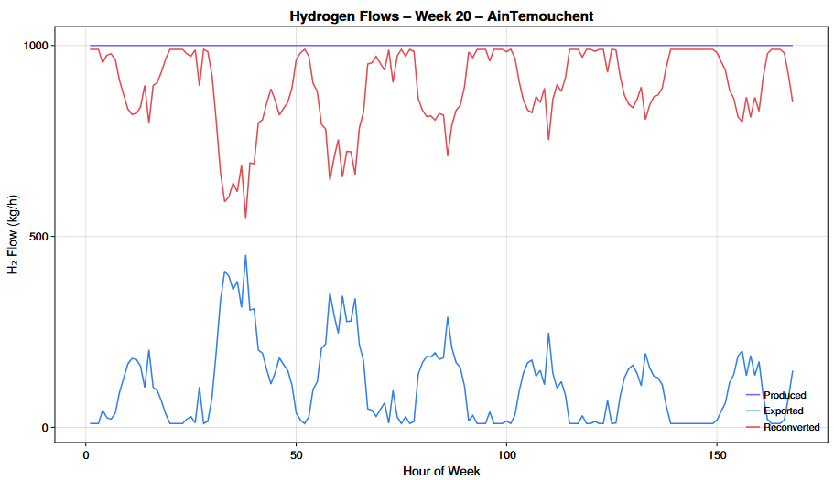
Results_Hydrogen production , storage and export dynamics
Source : own elaboration

Slide 13
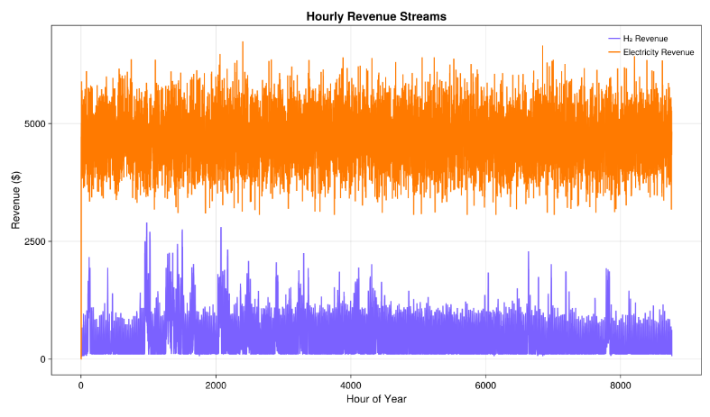
Results_Hourly hydrogen and electricity revenue streams
Source : own elaboration

Slide 14
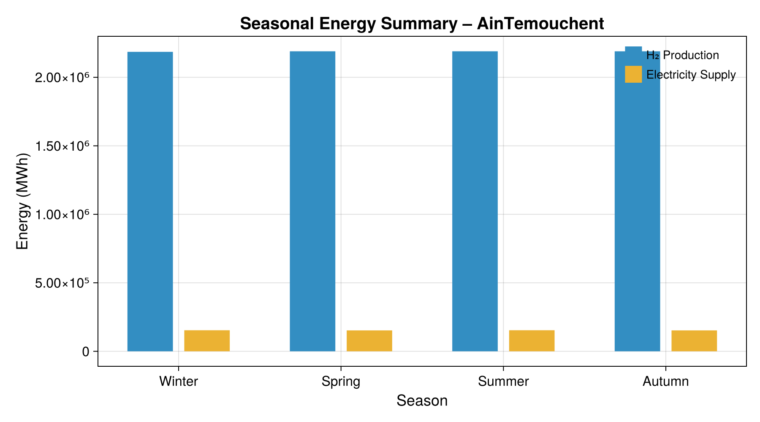
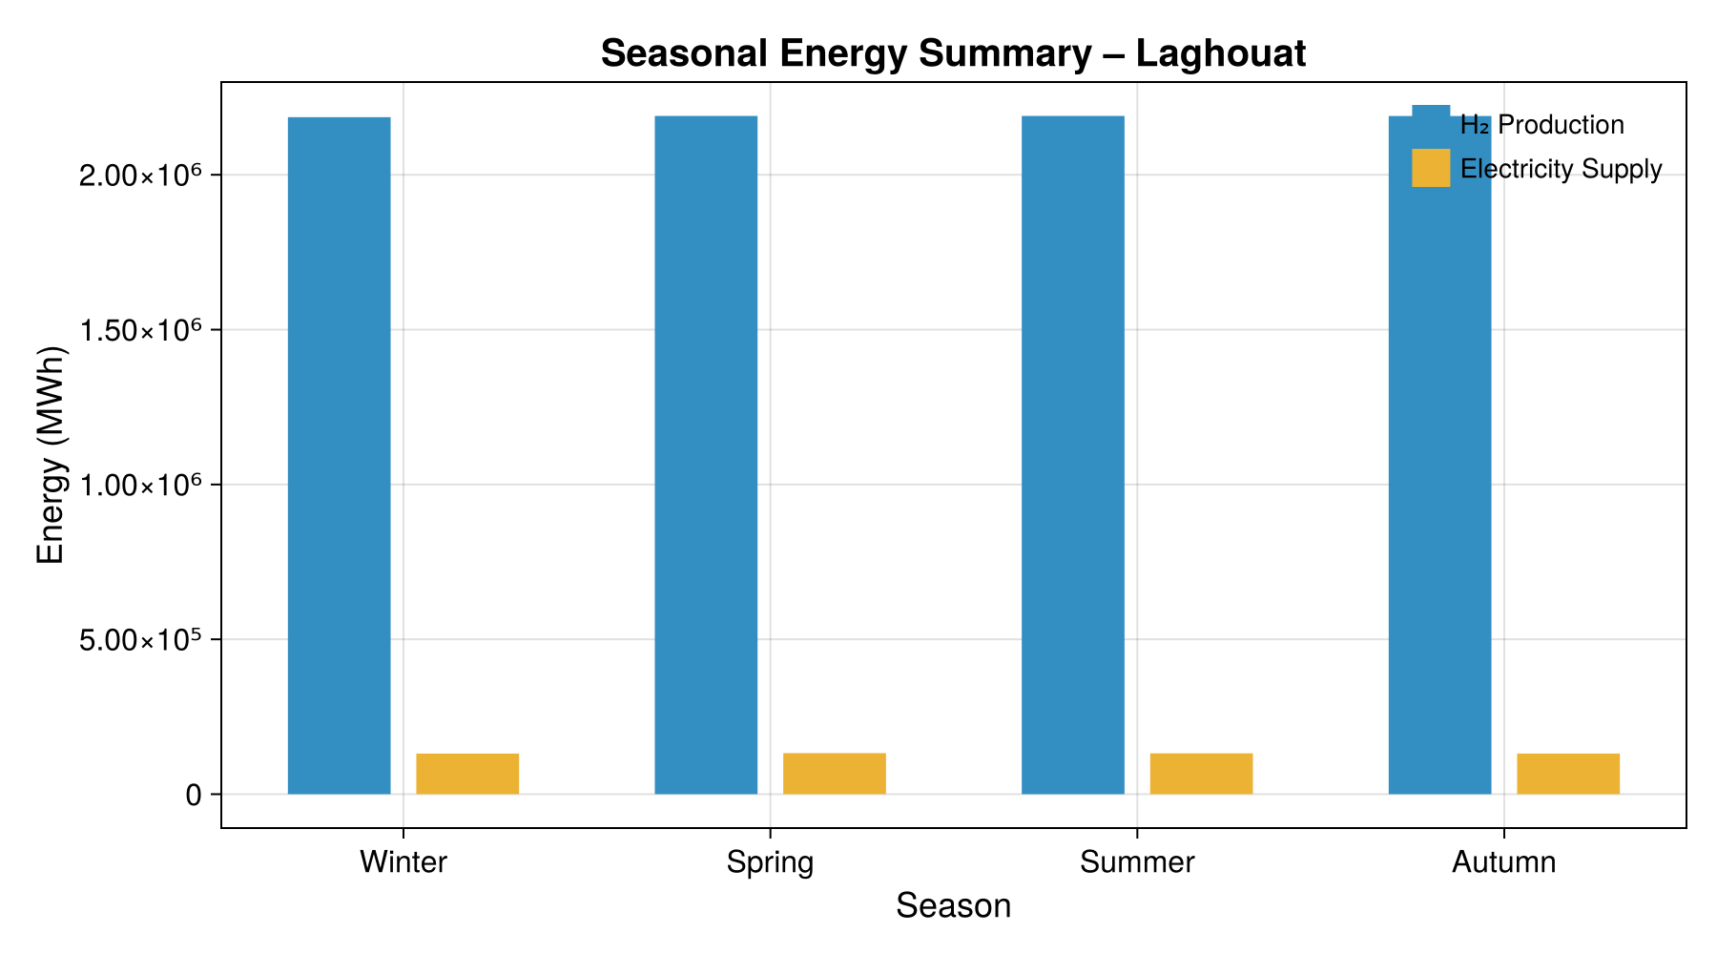
Results_Seasonal analysis of system operation
Source : own elaboration

Slide 15
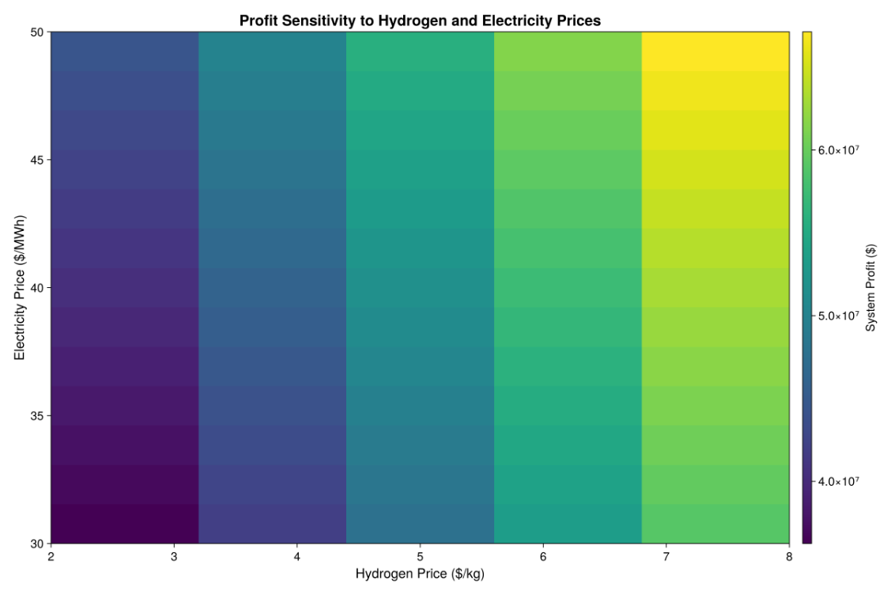
Results_Sensitivity analysis of Market prices
Source : own elaboration

Slide 16
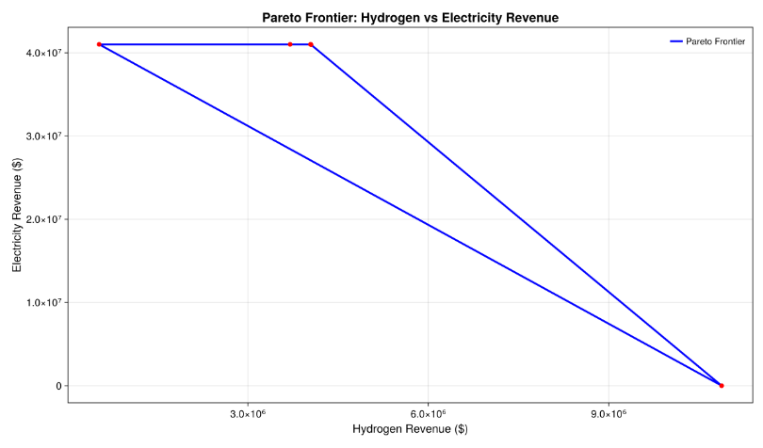
Results_Multi-objective optimization and Pareto analysis
Source : own elaboration

Slide 17
Conclusion and discussion
Hydrogen is Profitable in Algeria: Exporting hydrogen offers significant revenue opportunities, with economic returns highly influenced by international market prices.
Sustainable Water Supply: Desalinated water provides a reliable and sustainable solution for hydrogen production in water-scarce regions.
Electricity from Hydrogen: Hydrogen can be converted back to electricity, helping supply power in arid regions with variable renewable generation
Policy & Investment: Realizing Algeria’s hydrogen potential requires coordinated investments in renewable generation, hydrogen infrastructure, water systems, and transport networks.
Strategic Opportunity: Algeria has favorable conditions to become a competitive renewable hydrogen exporter to international markets.

Slide 18
Thank you for your attention
I welcome any questions or further discussion
Feel free to reach out for further research cooperation or discussion:
Nadji AGADI / Doctoral Researcher _Industrial Engineer(Berlin University of Technology)
E-mail: nadji.agadi@campus.tu-berlin.de

Slide 19
References:
21_12_07_Hydrogène_vert_en_Algérie_-_Rapport_PE.pdf. (n.d.). Retrieved October 16, 2023, from https://www.energypartnershipalgeria.org/fileadmin/user_upload/algeria/21_12_07_Hydrog%C3%A8ne_vert_en_Alg%C3%A9rie_-_Rapport_PE.pdf
Abdelkafi, A., & Krichen, L. (2014). Energy management optimization of a hybrid power production unit based on renewable energies. International Journal of Electrical Power & Energy Systems, 62, 1–9. https://doi.org/10.1016/j.ijepes.2014.04.012
Acar, C., & Dincer, I. (2020). The potential role of hydrogen as a sustainable transportation fuel to combat global warming. International Journal of Hydrogen Energy, 45(5), 3396–3406. https://doi.org/10.1016/j.ijhydene.2018.10.149
Arsad, A. Z., Hannan, M. A., Al-Shetwi, A. Q., Mansur, M., Muttaqi, K. M., Dong, Z. Y., & Blaabjerg, F. (2022). Hydrogen energy storage integrated hybrid renewable energy systems: A review analysis for future research directions. International Journal of Hydrogen Energy, 47(39), 17285–17312. https://doi.org/10.1016/j.ijhydene.2022.03.208
El-Emam, R. S., & Özcan, H. (2019). Comprehensive review on the techno-economics of sustainable large-scale clean hydrogen production. Journal of Cleaner Production, 220, 593–609. https://doi.org/10.1016/j.jclepro.2019.01.309
Schöne, N., Khairallah, J., & Heinz, B. (2022). Model-based techno-economic evaluation of power-to-hydrogen-to-power for the electrification of isolated African off-grid communities. Energy for Sustainable Development, 70, 592–608. https://doi.org/10.1016/j.esd.2022.08.020

Slide 20
Back-up slides

Slide 21
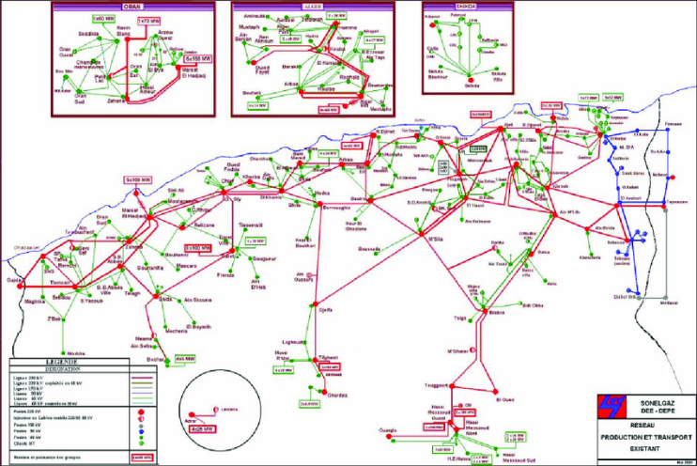
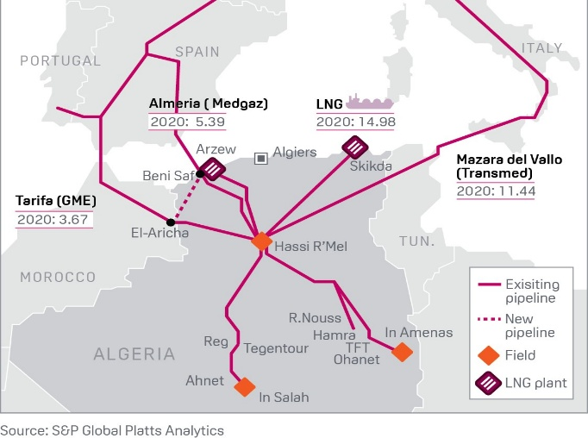
Back-up slides

Slide 22
