Slide 1

Hydrogen based electrification vs direct electrification using
solar PV and wind in Egypt: A HOMER PRO study
Presented by: Srishti Jain
Co-authors: Nadji Agadi, Khadidja Sakhraoui
The Economic and Infrastructure Policy (WIP) department TU Berlin

Slide 2
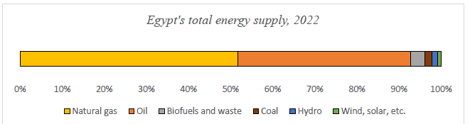
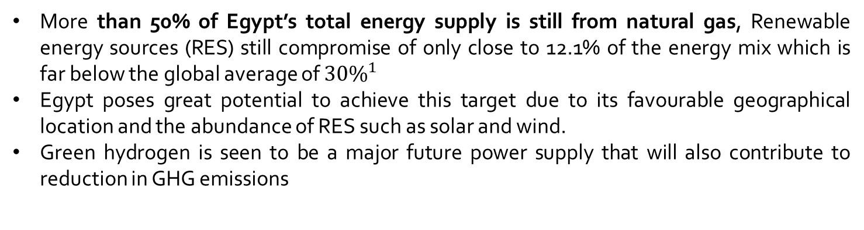
Introduction
More than 50% of Egypt’s total energy supply is still from natural gas, Renewable energy sources (RES) still compromise of only close to 12.1% of the energy mix which is far below the global average of ${30\%}^{1}$
Egypt poses great potential to achieve this target due to its favourable geographical location and the abundance of RES such as solar and wind.
Green hydrogen is seen to be a major future power supply that will also contribute to reduction in GHG emissions

Slide 3

Problem Statement
Green hydrogen-based electrification emerges as a promising solution in providing a link between growing RE generation and sectors where emissions are the hardest to abate such as steel, cement and it promises benefits such as additional system flexibility and storage, energy security, reduced GHG emissions and other socio-economic benefits such as job creation and industrial competitiveness.
However, barriers exist in realizing the full potential of green hydrogen. Key among them is the cost. Even though the cost of green hydrogen is falling globally, it is still 2-3 times more expensive than blue hydrogen$.^{2}$
Conversely, direct electrification utilizing solar photovoltaic and wind energy is known for its efficiency and relatively lower costs. Yet, it faces limitations related to its variable nature, battery storage, capacity constraints and degradation over time.
Given these considerations, there is uncertainty regarding which system-hydrogen-based or direct electrification is more suitable for Egypt's energy transition. A comprehensive comparative analysis is essential to evaluate the techno-economic feasibility of both approaches within the Egyptian context.

Slide 4
Research objective
This study aims to:
Compare the Techno-Economic Feasibility: Assess the technical and economic viability of hydrogen-based electrification versus direct electrification using solar PV and wind energy in Egypt.
Model Energy Systems Using HOMER Pro: Utilize the HOMER PRO software to simulate both systems, analysing key parameters including cost, efficiency, scalability, and environmental impact.
Evaluate Suitability for addressing energy security: Investigate the suitability of each system in addressing the energy needs of the country, considering factors such as energy reliability, storage requirements, and operational sustainability.
Provide Policy Recommendations: Based on the analysis, offer informed policy suggestions to guide Egypt's renewable energy strategy, facilitating an effective and sustainable energy transformation.

Slide 5
Research Questions
To achieve these objectives, the study will address the following research questions:
Techno-Economic Comparison: What are the comparative costs and efficiencies of hydrogen-based electrification versus direct electrification using solar PV and wind energy in Egypt?
System Modeling with HOMER PRO: How do simulations of hydrogen-based and direct electrification systems, conducted using HOMER Pro, differ?What is the long-term feasibility of both systems and how scalable are they? What are the challenges to scaling hydrogen-based electrification.
Policy Implications: What policy recommendations can be derived from the comparative analysis to support Egypt's renewable energy strategy?

Slide 6
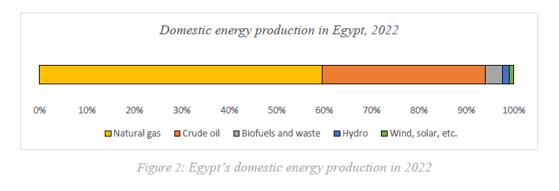
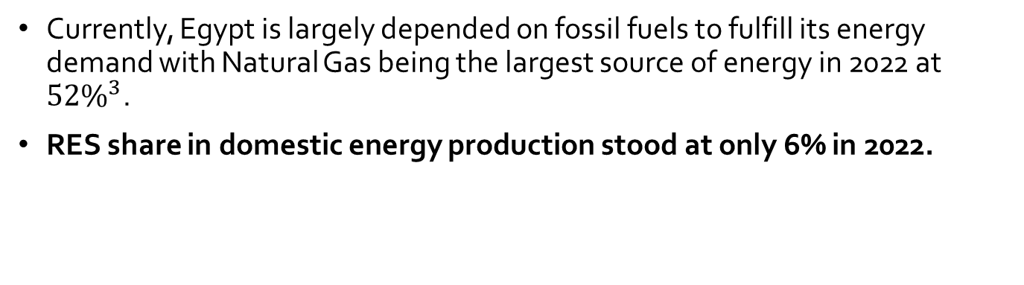
Egypt‘s current energy context
Currently, Egypt is largely depended on fossil fuels to fulfill its energy demand with Natural Gas being the largest source of energy in 2022 at ${52\%}^{3}$.
RES share in domestic energy production stood at only 6% in 2022.

Slide 7
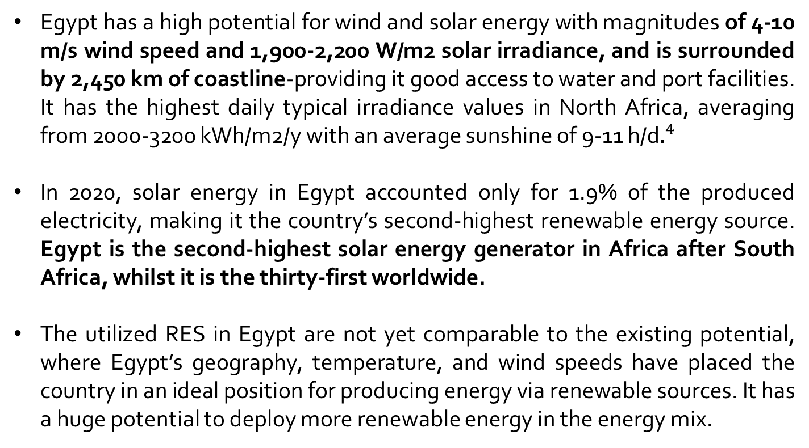
Solar and wind potential in Egypt
Egypt has a high potential for wind and solar energy with magnitudes of 4-10 m/s wind speed and 1,900-2,200 W/m2 solar irradiance, and is surrounded by 2,450 km of coastline-providing it good access to water and port facilities. It has the highest daily typical irradiance values in North Africa, averaging from 2000-3200 kWh/m2/y with an average sunshine of 9-11 h/d$.^{4}$
In 2020, solar energy in Egypt accounted only for 1.9% of the produced electricity, making it the country’s second-highest renewable energy source. Egypt is the second-highest solar energy generator in Africa after South Africa, whilst it is the thirty-first worldwide.
The utilized RES in Egypt are not yet comparable to the existing potential, where Egypt’s geography, temperature, and wind speeds have placed the country in an ideal position for producing energy via renewable sources. It has a huge potential to deploy more renewable energy in the energy mix.
4. CSR portal: Govt of India

Slide 8
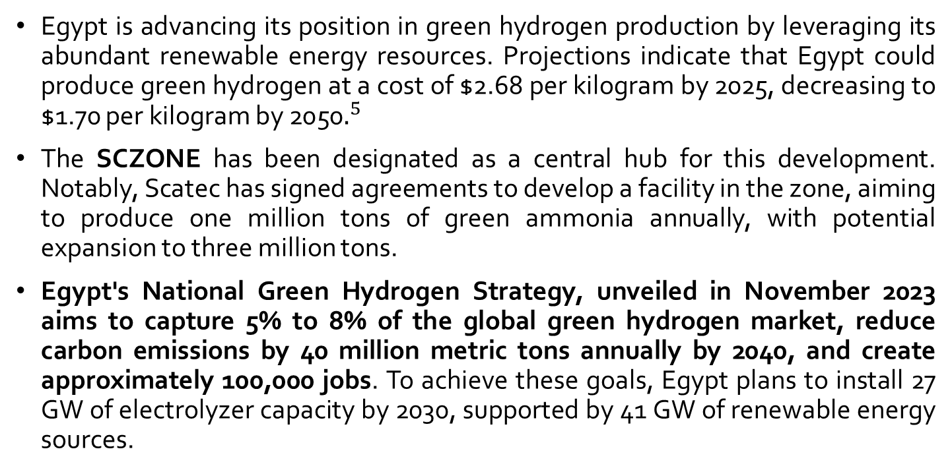
Green hydrogen in Egypt
Egypt is advancing its position in green hydrogen production by leveraging its abundant renewable energy resources. Projections indicate that Egypt could produce green hydrogen at a cost of $2.68 per kilogram by 2025, decreasing to $1.70 per kilogram by 2050$.^{5}$
The SCZONE has been designated as a central hub for this development. Notably, Scatec has signed agreements to develop a facility in the zone, aiming to produce one million tons of green ammonia annually, with potential expansion to three million tons.
Egypt's National Green Hydrogen Strategy, unveiled in November 2023 aims to capture 5% to 8% of the global green hydrogen market, reduce carbon emissions by 40 million metric tons annually by 2040, and create approximately 100,000 jobs. To achieve these goals, Egypt plans to install 27 GW of electrolyzer capacity by 2030, supported by 41 GW of renewable energy sources.

Slide 9
Methodology
This study adopts a quantitative techno-economic analysis to compare hydrogen-based electrification and direct electrification using solar PV and wind energy in Egypt. The comparison is conducted using the HOMER PRO software, a hybrid energy system simulation tool, to assess technical, economic, and environmental performance indicators.
Two system configurations are modeled:
Model 1: Direct Electrification (Solar PV + Wind + Battery+ converter+ electric load)
Model 2: Hydrogen-Based Electrification (Solar PV + Wind + Battery + Electrolyzer + Hydrogen Storage + Hydrogen load)
Both systems are simulated under identical resources and load conditions for a fair comparison.
HOMER PRO was selected for this study due to its integrated capabilities in modeling hybrid renewable energy systems with hydrogen components.

Slide 10
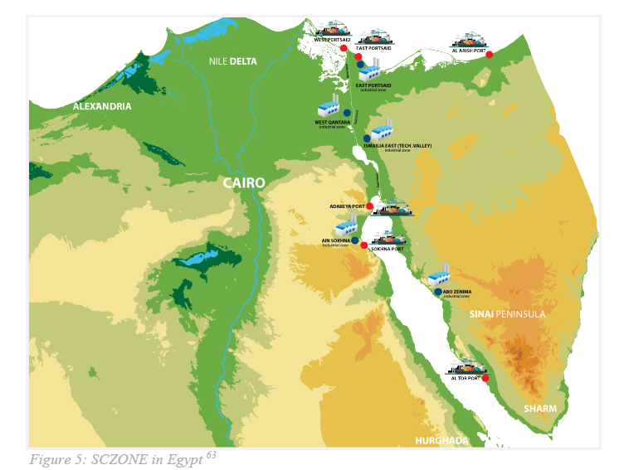
Location for the study
For this study, SCZONE has been chosen as the study location.
The selection of the zone as a study area for hydrogen production in Egypt is driven by its strategic location, well-developed infrastructure, and government initiatives promoting renewable energy projects.

Slide 11
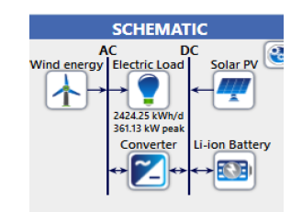
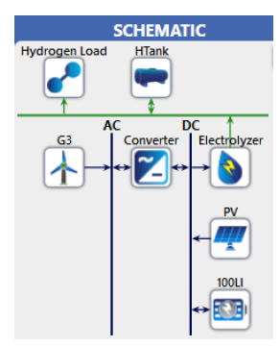
Models and system configuration (1/2)
Model 1: Direct Electrification
Components
  Solar PV arrays
  Wind turbines
  Lithium-ion battery storage
  Converter (inverter)
  Electric load
System Description: Electricity generated from PV and wind directly supplies the load. Surplus energy is stored in batteries for later use during periods of low generation.
Model 2: Hydrogen-Based Electrification
Components
  Solar PV arrays
  Wind turbines
  Lithium-ion battery storage
  Converter (inverter)
Electrolyzer
Hydrogen storage tank
Hydrogen load

Slide 12
Models and system configuration (2/2)
Model 2: Hydrogen-Based Electrification
  In HOMER PRO, electricity first meets the load and then the excess energy is used to produce hydrogen via electrolysis, stored in tanks, and later reconverted into electricity through fuel cells when needed. However, for this study, we need the RE to produce only hydrogen. Therefore, the model is split into two parts
1.Solar PV+ wind turbines+ Electrolyzer+ hydrogen load+ Hydrogen storage tank+ converter+ Lithium-ion battery storage
2. Stored hydrogen+ fuel cell+ electric load
This way, HOMER PRO is used to simulate the part one where RE is used to produce hydrogen via electrolysis and then in part 2, the hydrogen thus produced is used to serve the electric load.

Slide 13
Results
The zone benefits from favourable renewable resources. Average wind speed in the region is 5.3 m/s and solar irradiance averages 5.45 kWh/m²/day. A consistent load profile of 2,424.25 kWh/day (884,786 kWh/year) was used The simulation was run at an hourly resolution (8,760 steps) for a one-year period.
Model 1 consists of:
Model 2 consists of:
Component | Specification
Generic Flat-Plate Solar PV | (350 kW)
Wind Turbines | (3 kW × 80 units = 240 kW)
Lithium-Ion Batteries | (100 kWh)
System converter | (10 kW)
Component | Specification
Generic Flat-Plate Solar PV | 270 KW
Wind Turbines | 2 × 3 kW = 6 kW
Lithium-Ion Batteries | 1 × 100 kWh Li-ion
System converter | 0.208 kW
Electrolyzer | 300 KW capacity
Hydrogen Tank | 500 kg capacity

Slide 14
Simulation Results Model 1: Direct Electrification
Metric | Value | Metric | Value
Net Present Cost (NPC) | $2,673,863 | Unmet Load | 134 kWh/year
Levelized Cost of Electricity (LCOE) | $0.23/kWh | Unmet Load (%) | 0.01
Total Operating Cost (Annual) | $82,502.84 | Capacity Shortage | 856 kWh/year
Total Capital Cost | $1,607,306.43 | Renewable Fraction | 100%
Total Replacement Cost | $426,822.20 | Max. Renewable Penetration | 2,362%
Total O&M Cost | $720,066.81 | PV Contribution | 48.5%
Total Electricity Production | 1,227,377 kWh/year | Wind Contribution | 51.5%
Electricity Consumption | 884,718 kWh/year | CO₂ Emissions | 0 (Fully Renewable)
Excess Electricity | 251,733 kWh/year
Excess Electricity (%) | 20.5

Slide 15
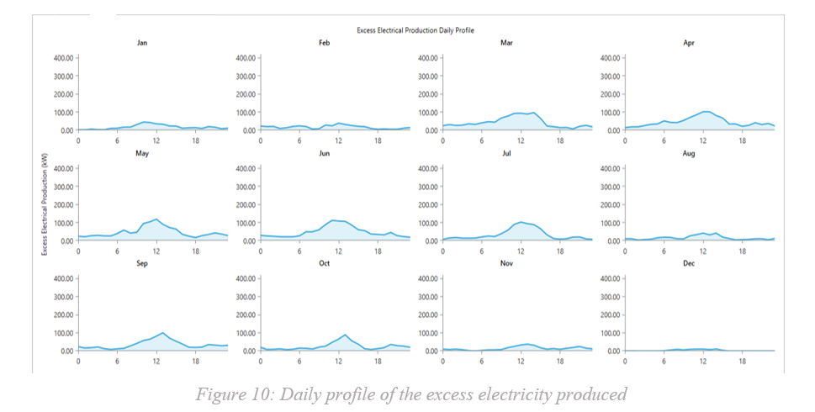
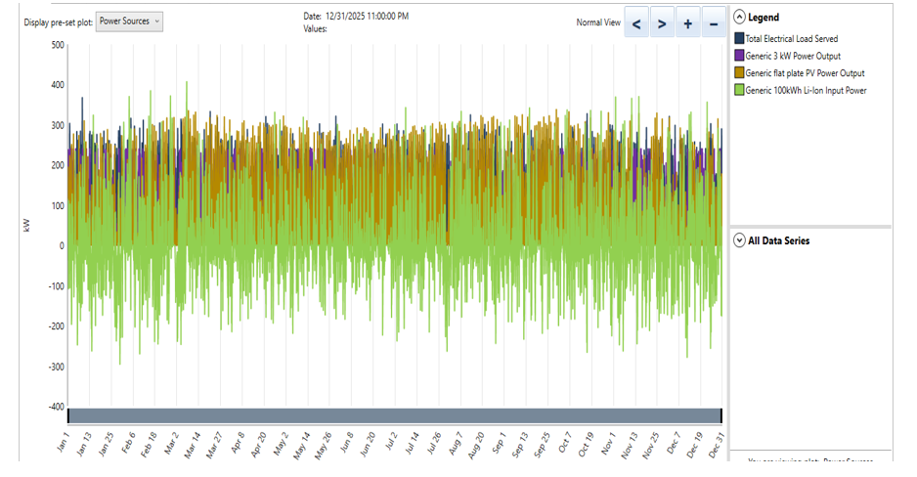
Simulation Results Model 1: Direct Electrification
Due to renewable intermittency and mismatch between generation and load timing, the system produces 251,733 kWh (~20%) of the electricity excess to the total generation
Histogram showing total electrical load served, RE power output and battery power

Slide 16
Simulation Results Model 2: Hydrogen based electrification
Metric | Value | Metric | Value
Net Present Cost (NPC) | $963,816 | Hydrogen Produced | 7,017 kg/year
Levelized Cost of Hydrogen (LCOH) | $10.6/kg | Hydrogen Used | 6,989 kg/year
Total Operating Cost (Annual) | $14,647 | Unmet Hydrogen Load | 0 kg/year
Total Capital Cost | $774,464 | Unmet Hydrogen Load (%) | 0%
Total Replacement Cost | $132,188 | Hydrogen Tank Start Level | 250 kg
Total O&M Cost | $82,042 | Hydrogen Tank End Level | 278 kg
Total Electricity Production | 474,774 kWh/year | PV Contribution | 96.7%
Electricity to Electrolyzer | 425,819 kWh/year | Wind Contribution | 3.3%
Excess Electricity | 48,889 kWh/year | CO₂ Emissions | 0 (Fully Renewable)
Excess Electricity (%) | 10.3%

Slide 17
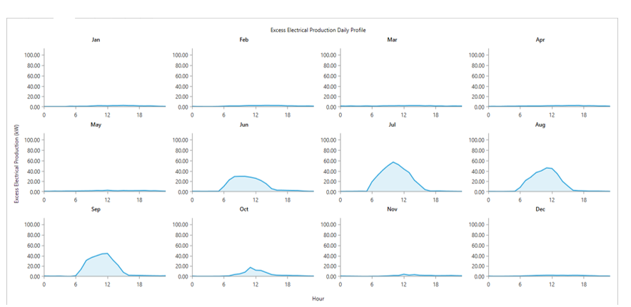
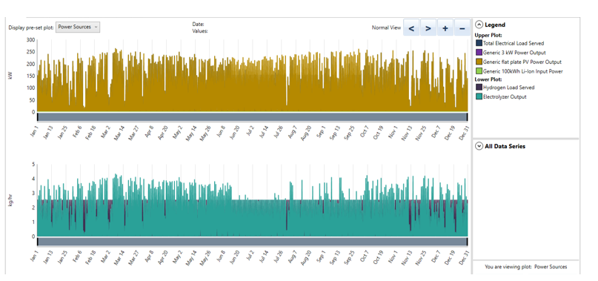
Simulation Results Model 2: Hydrogen based electrification
The system produced roughly 10.3% of excess electricity which was unused due to the electrolyzer’s size limit and tank capacity constraints.
Histogram depicting the details of the hydrogen load served

Slide 18
Techno-economic evaluation
The LCOH calculated as the total discounted cost divided by the total hydrogen produced over the system’s lifetime is $10.6/kg. This value is notably higher than global green hydrogen benchmarks (typically $4–$6/kg), which reflects the small scale of the system, limited renewable capacity, and lack of economies of scale.
Since no electricity is directly supplied to an end-user in this part of the model, the LCOE is not computed.
Operational Performance
Notably, the hydrogen produced in this configuration, when converted into electricity using a typical fuel cell efficiency of 50%, would yield only :
6,989kg X 33.33 KWh/kg X 0.50 = 116,466Kwh/year
Compared to the electrical load of 884,718 kWh/year (as served in Model 1), this output represents just 13.2% of the demand indicating that the current PV and wind capacity are insufficient to support a full-scale hydrogen-based electrification pathway.

Slide 19
Key metric summary and comparison of models
Metric | Model 1 | Model 2
Net Present Cost | $2,673,863 | $1,155,031 (with fuel cell)
LCOE / LCOH | $0.2338/kWh | $0.3967/kWh (LCOE with fuel cell) / $10.6/kg H₂
Total Electricity Production | 1,227,377 kWh/year | 474,774 kWh/year
Electricity to Load / Electrolyzer | 884,718 kWh/year | 425,819 kWh/year
Electricity Delivered (Final) | 884,584 kWh/year | 116,466 kWh/year
Excess Electricity | 251,733 kWh/year (20.5%) | 48,889 kWh/year (10.3%)
Emissions | 0 (Renewable) | 0 (Renewable)
Model 1 presents lower lifecycle energy cost per unit delivered, due to its direct conversion of solar and wind energy into usable electricity. Model 2's higher LCOE of approximately $0.40/kWh (including fuel cell cost) is attributed to multi-step conversion losses and additional capital costs. While Model 2's initial NPC is lower, the effective energy service output is considerably less. The higher LCOH value ($10.6/kg) in Model 2 exceeds the global range of $4.5–6.5/kg reported in 2024 by the Hydrogen Council (Hydrogen Council, 2023), which reflects the impact of limited economies of scale and moderate capacity factor.

Slide 20
Conclusion and policy recommendations
Our findings suggest that while direct electrification via solar PV and wind energy is the more cost-effective and energy-efficient option for domestic energy needs, hydrogen-based systems though currently more expensive and less efficient are strategically valuable for export markets, industrial decarbonization, and seasonal storage. Therefore, a dual policy pathway is necessary: one optimized for short-term domestic supply, the other focused on long-term industrial and export potential.
Direct electrification should be prioritized for short- to medium-term domestic deployment, while hydrogen infrastructure should be developed in parallel for industrial use, international trade, and long-term resilience.
This balanced approach ensures that Egypt addresses both its immediate energy access challenges and its broader economic and climate ambitions. .

Slide 21
References
Ember. 2024. "World Passes 30% Renewable Electricity Milestone." May 7, 2024. https://ember-climate.org/press-releases/world-passes-30-renewable-electricity-milestone/.
IRENA (2021), Making the breakthrough: Green hydrogen policies and technology costs, International Renewable Energy Agency, Abu Dhabi.
International Energy Agency (IEA). 2024. “Egypt: Energy Mix.” Accessed May 16, 2025. https://www.iea.org/countries/egypt/energy-mix.
Breuning, Larissa, Andrea Cadavid Isaza, Julia Gawlick, Anđelka Kerekeš, and Thomas Hamacher. 2024. “Combined Photovoltaic and Wind Power Plant Planning for the Production and Transportation of Liquefied Green Hydrogen: A Case Study of Egypt.” International Journal of Hydrogen Energy 49 (January):150–65. https://doi.org/10.1016/j.ijhydene.2023.07.108.
Egypt Oil & Gas. (2022). Electricity Minister: Egypt Can Produce Green Hydrogen at the Lowest Costs. Retrieved from https://egyptoil-gas.com/news/electricity-minister-egypt-can-produce-green-hydrogen-at-the-lowest-costs/

Slide 22
Thankyou!
.

